Slide 1


Cleiton Camilo
23 August 2024

Slide 2

Outline
Executive Summary
Introduction
Methodology
Results
Conclusion
Appendix

Slide 3
Executive Summary
Summary of methodologies
Utilized Python libraries (Pandas, Seaborn, Matplotlib) for data analysis and visualization.
Analyzed launch data to uncover trends, success rates, and relationships between key variables like payload mass, orbit type, and flight number.
Employed machine learning techniques to model and predict launch outcomes.
Summary of all results
Identified key trends in launch success rates over the years.
Uncovered relationships between payload mass, orbit type, and launch success.
Successfully modeled and predicted launch outcomes using various machine learning algorithms.

Slide 4
Introduction
Project background and context
SpaceX has conducted numerous launches, with varying outcomes depending on factors like payload mass, orbit type, and launch site.
This project aims to analyze historical SpaceX launch data to uncover patterns and trends that can help predict future outcomes and improve launch success rates.
Problems you want to find answers
How do different orbit types affect the success rate of launches?
Is there a correlation between payload mass and launch success?
What trends in launch success can be observed over the years?
Which machine learning models can most accurately predict the outcome of future launches?

Slide 5

Section 1

Slide 6
Methodology
Executive Summary
Data collection methodology:
Data was sourced from SpaceX's publicly available launch datasets, accessed through online repositories.
The dataset includes key features such as FlightNumber, LaunchSite, Orbit, PayloadMass, and Class (launch outcome).
Perform data wrangling
The data underwent preprocessing to handle missing values, convert data types, and extract relevant features like the year from the launch date.
Data was standardized and split into training and testing sets for modeling purposes.
Perform exploratory data analysis (EDA) using visualization and SQL
Perform interactive visual analytics using Folium and Plotly Dash
Perform predictive analysis using classification models
Machine learning models including Logistic Regression, SVM, Decision Trees, and K-Nearest Neighbors were built and tuned using GridSearchCV.
Models were evaluated based on their accuracy in predicting the success of future launches.

Slide 7
Data Collection
Source: Data was collected from publicly available SpaceX launch datasets provided via online repositories.
Access Method: The data was retrieved using Python's requests library and directly imported into Pandas DataFrames for analysis.
Data Composition: The dataset includes information on various aspects of SpaceX launches such as flight number, launch site, orbit type, payload mass, and whether the launch was successful.
Identify Data Source
Data Retrieval
Data Import
Initial Inspection

Slide 8
Data Collection – SpaceX API
Key Steps:
API Endpoint Identification: Determined the specific API endpoints needed to retrieve SpaceX launch data (e.g., rockets, launch pads, payloads).
API Request: Used Python's requests library to send HTTP GET requests to the SpaceX API.
Data Extraction: Parsed the JSON responses to extract relevant data fields like flight numbers, launch sites, orbit types, and payload masses.
Data Storage: Stored the retrieved data in Pandas DataFrames for further analysis.
External Reference:
coursera/jupyter-labs-spacex-data-collection-api.ipynb at main · Cleitonjr/coursera (github.com)
API Endpoint Identification
API Request
Data Extraction
Data Storage

Slide 9
Data Collection - Scraping
Identify Target Website: Selected a website containing historical SpaceX launch data (e.g., Wikipedia page listing SpaceX launches).
Use Python Libraries for Scraping: Employed Python libraries such as requests to fetch the webpage's HTML content and BeautifulSoup to parse and extract specific data points.
Data Extraction: Scraped relevant tables and extracted information such as flight numbers, launch dates, payload masses, orbit types, and launch outcomes.
Data Cleaning: Processed and cleaned the scraped data to ensure it was in a structured format suitable for analysis (e.g., handling missing values, converting data types).
Storage: Stored the cleaned data in Pandas DataFrames for further analysis and visualization.
coursera/jupyter-labs-webscraping.ipynb at main · Cleitonjr/coursera (github.com)
Identify Target Website
Use Python Libraries for Scraping
Data Extraction
Data Cleaning
Storage

Slide 10
Data Wrangling
Handling Missing Data:
Identified and handled missing values through techniques such as imputation or removal to ensure the integrity of the dataset.
Data Type Conversion:
Converted data types as necessary, such as changing date strings to datetime objects and ensuring numeric fields were in the correct format.
Feature Engineering:
Created new features from existing data, such as extracting the year from the launch date or categorizing payload mass into different bins.
Data Normalization and Standardization:
Applied normalization or standardization to numerical features to ensure consistency and improve model performance.
coursera/labs-jupyter-spacex-Data wrangling.ipynb at main · Cleitonjr/coursera (github.com)
Data Inspection
Cleaning
Transformation
Integration

Slide 11
EDA with Data Visualization
Scatter Plots:
Purpose: Used to explore relationships between two continuous variables. For example, plotting PayloadMass against FlightNumber helped identify any trends or patterns related to the payload mass and its effect on launch outcomes.
Bar Charts:Purpose:
Utilized to compare categorical data, such as the success rate of different orbit types. Bar charts made it easy to compare the success rates across various categories.
Line Charts:
Purpose: Created to visualize trends over time, such as the yearly trend of launch success rates. This helped in understanding how SpaceX’s success rate has improved or declined over the years.
Heatmaps:
Purpose: Used to display the correlation between different variables, helping identify which factors might be strongly associated with successful launches.
coursera/jupyter-labs-eda-sql-coursera_sqllite.ipynb at main · Cleitonjr/coursera (github.com)

Slide 12
EDA with SQL
Query 1: Extract Unique Launch SitesIdentified and listed all the unique launch sites present in the dataset to understand the distribution of launches.
Query 2: Filter Records by Launch SiteRetrieved records for launches from specific sites (e.g., those starting with 'CCA') to focus on site-specific analysis.
Query 3: Calculate Total Payload Mass by NASA MissionsSummed the payload masses for all missions launched by NASA, providing insight into the total payload managed by NASA.
Query 4: Average Payload Mass for Specific Booster VersionsCalculated the average payload mass for launches using the F9 v1.1 booster version to assess its performance.
Query 5: Identify First Successful Landing on Ground PadQueried the dataset to find the date of the first successful landing on a ground pad, marking a significant milestone in SpaceX's history.
Query 6: Analyze Successful Drone Ship Landings with Specific PayloadsFiltered data to list successful drone ship landings where the payload mass was between 4000 and 6000 kg, identifying key missions within this range.
Query 7: Total Number of Successful vs. Failed MissionsCounted the number of successful and failed missions, providing a high-level overview of SpaceX’s success rate.
Query 8: Max Payload Carried by Booster VersionsUsed subqueries to determine which booster versions carried the maximum payload, highlighting the most powerful boosters.
Query 9: Analyze 2015 Missions by MonthRetrieved records of missions from 2015, analyzing them by month to understand the frequency and success of launches during that year.
Query 10: Rank Landing OutcomesRanked the different landing outcomes (e.g., success on ground pad, failure on drone ship) between specific dates to evaluate the consistency of landings.
coursera/jupyter-labs-eda-sql-coursera_sqllite.ipynb at main · Cleitonjr/coursera (github.com)

Slide 13
Build an Interactive Map with Folium
Summarize what map objects such as markers, circles, lines, etc. you created and added to a folium map
Explain why you added those objects
Add the GitHub URL of your completed interactive map with Folium map, as an external reference and peer-review purpose

Slide 14
Build a Dashboard with Plotly Dash
Summarize what plots/graphs and interactions you have added to a dashboard
Explain why you added those plots and interactions
Add the GitHub URL of your completed Plotly Dash lab, as an external reference and peer-review purpose

Slide 15
Predictive Analysis (Classification)
Summarize how you built, evaluated, improved, and found the best performing classification model
You need present your model development process using key phrases and flowchart
Add the GitHub URL of your completed predictive analysis lab, as an external reference and peer-review purpose

Slide 16
Results
Exploratory data analysis results
Interactive analytics demo in screenshots
Predictive analysis results

Slide 17

Section 2

Slide 18
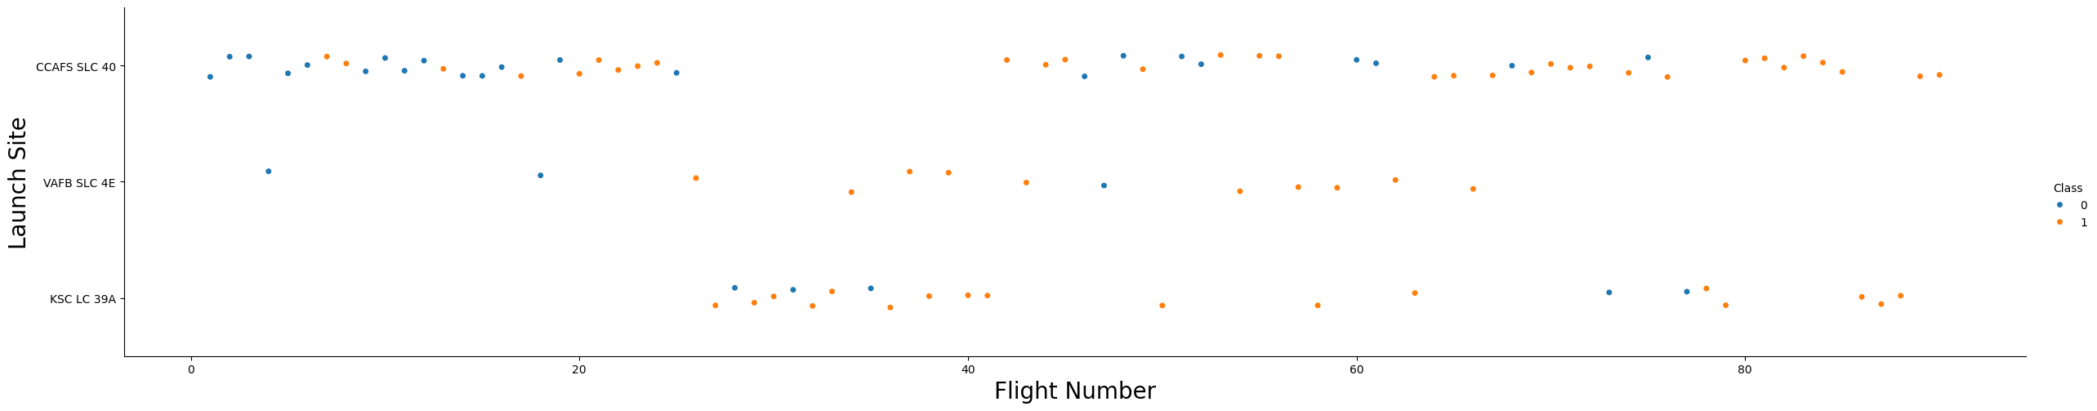
Flight Number vs. Launch Site
The scatter plot demonstrates the distribution of launches across different sites (CCAFS SLC-40, VAFB SLC-4E, and KSC LC-39A) over time.
It highlights how the majority of early launches were concentrated at specific sites and how success rates improved as the flight number increased.
The plot also indicates that certain launch sites, such as KSC LC-39A, were used for more recent launches, reflecting operational changes over time.
Success vs. Failure:
The scatter plot shows that earlier flights had a higher failure rate, indicated by the orange dots (Class = 0).
As the flight numbers increased, the success rate improved significantly, shown by the increasing number of blue dots (Class = 1).

Slide 19
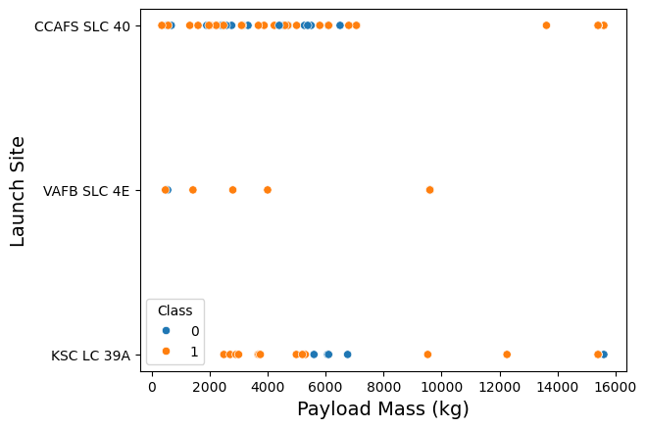
Payload vs. Launch Site
The plot shows the distribution of payload masses across different launch sites (CCAFS SLC-40, VAFB SLC-4E, KSC LC-39A).
It highlights the varying payload capacities handled by each launch site.The distribution suggests that some sites were used for heavier payloads, whereas others consistently handled lighter payloads.
Success vs. Failure:
The scatter plot reveals that launches with lower payloads generally had a higher success rate, shown by the blue dots (Class = 1).
Conversely, some launches with heavier payloads had higher failure rates, indicated by the orange dots (Class = 0), especially at certain launch sites.

Slide 20
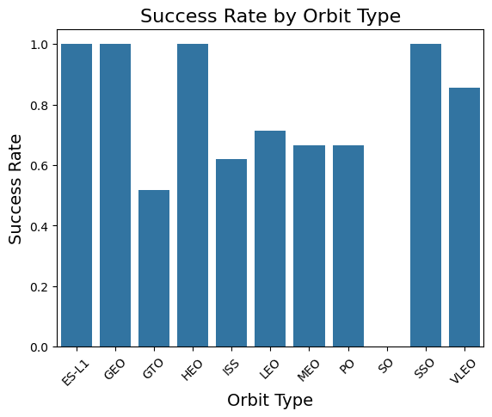
Success Rate vs. Orbit Type
The chart shows that certain orbit types, such as ES-L1, GEO, and HEO, have a higher success rate (close to 100%).
Other orbits, such as GTO and SSO, display a more varied success rate, with GTO having a notably lower success rate compared to others.
The variation in success rates across different orbit types may be due to the varying levels of difficulty and complexity associated with achieving each orbit.
Key Insights: The VLEO orbit, although less commonly used, also shows a relatively high success rate.

Slide 21
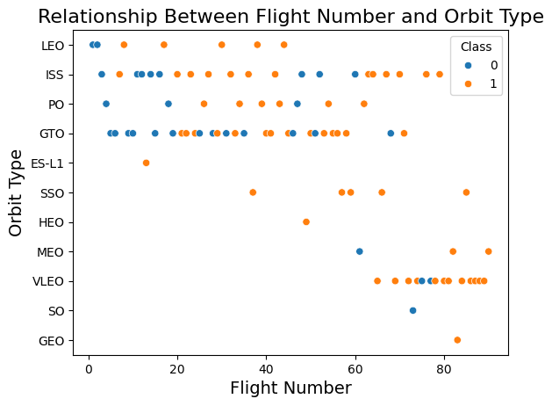
Flight Number vs. Orbit Type
The plot reveals how different orbit types are associated with varying flight numbers. For example, orbits like LEO and ISS show a dense concentration of successful launches, indicated by the blue dots.
Certain orbit types, such as GTO and SSO, show a more balanced distribution of successes and failures across different flight numbers.
The chart also highlights the progression of launches across orbit types as SpaceX continued to develop and refine its technologies over time.
Key Insights:
The success rates for specific orbit types, such as LEO and ISS, tend to be higher with higher flight numbers, suggesting increased reliability in these orbits as experience grew.
The presence of more orange dots (failures) in lower flight numbers for certain orbit types indicates the challenges faced during the early stages of development.

Slide 22
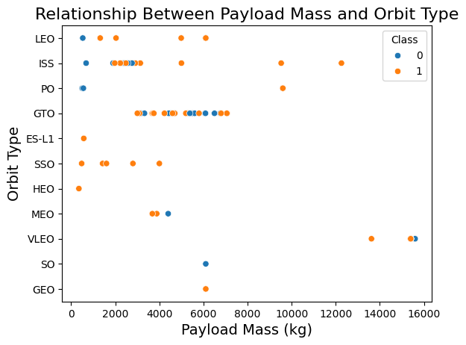
Payload vs. Orbit Type
The plot shows that certain orbits, such as LEO and ISS, accommodate a wide range of payload masses, with many successful launches even at higher masses.
For orbits like GTO and SSO, the success rates appear to vary more significantly with payload mass, as shown by the mix of blue and orange dots.
Some orbits, like GEO and SO, are associated with fewer launches, but these tend to involve either very low or very high payloads, with mixed success rates.
Key Insights:
The relationship between payload mass and success rate is orbit-dependent, with some orbits handling heavier payloads more reliably than others.
This plot helps identify which orbit types might require more robust technology or careful planning when dealing with heavier payloads to ensure mission success.

Slide 23
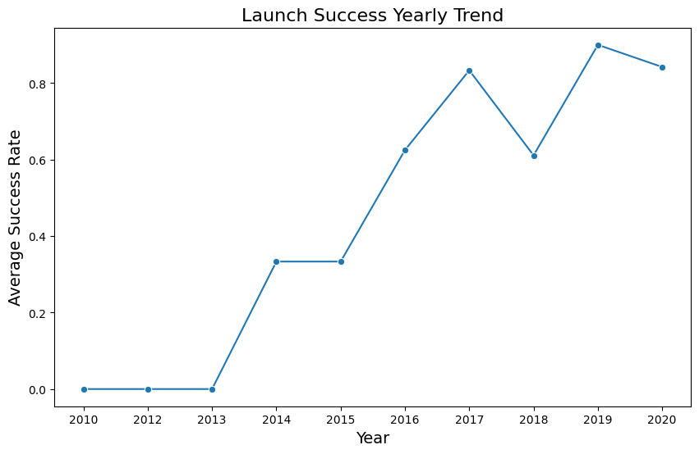
Launch Success Yearly Trend
The chart illustrates a clear upward trend in SpaceX's launch success rates from 2010 to 2020.Significant improvements are observed starting around 2014, where the success rate increases dramatically, indicating technological advancements and better launch strategies.
There are minor dips in certain years, such as 2017 and 2019, which could be attributed to specific challenges or anomalies in those years, but overall, the trend is positive.
Key Insights:
The consistent increase in success rates suggests that SpaceX has been effectively learning from past missions and continuously improving its processes and technologies.
The high success rate approaching 1.0 in recent years indicates a strong level of reliability and confidence in their launch systems.

Slide 24
All Launch Site Names
CCAFS LC-40
VAFB SLC-4E
KSC LC-39A
CCAFS SLC-40
%sql SELECT DISTINCT "Launch_Site" FROM SPACEXTBL;
The query uses the DISTINCT keyword to return only unique values from the Launch_Site column in the SPACEXTBL table.

Slide 25
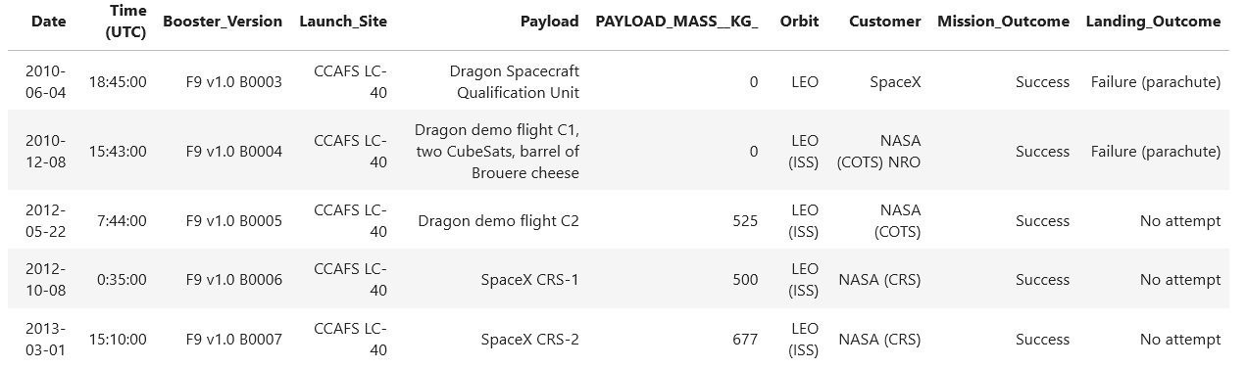
Launch Site Names Begin with 'CCA'
%sql SELECT * FROM SPACEXTBL WHERE "Launch_Site" LIKE 'CCA%' LIMIT 5;
The WHERE clause filters the records where the Launch_Site column starts with "CCA". The LIKE 'CCA%' condition is used to match any Launch_Site that begins with the string "CCA". The % wildcard represents any sequence of characters that follow "CCA". The LIMIT 5 clause restricts the result to only 5 records.

Slide 26
Total Payload Mass
107010
%sql SELECT SUM("PAYLOAD_MASS__KG_") AS Total_Payload_Mass FROM SPACEXTBL WHERE "Customer" LIKE '%NASA%’;
The SUM("PAYLOAD_MASS__KG_") function calculates the total payload mass in kilograms. The WHERE clause filters the records to include only those where the Customer column contains "NASA". The LIKE '%NASA%' condition is used to match any record where "NASA" appears in the Customer field. The result is stored in the alias Total_Payload_Mass.
The result shows the sum of all payload masses for launches where NASA was the customer. This calculation provides insight into the total mass that NASA has delivered to space using SpaceX's launch vehicles, highlighting NASA's contribution to the overall payload capacity handled by SpaceX.

Slide 27
Average Payload Mass by F9 v1.1
2928.4
The AVG("PAYLOAD_MASS__KG_") function calculates the average payload mass in kilograms. The WHERE clause filters the records to include only those where the Booster_Version is 'F9 v1.1’. The result is stored in the alias Average_Payload_Mass.
The result shows the average mass of payloads that were launched using the F9 v1.1 booster version. This calculation provides insight into the typical payload capacity handled by this specific booster version, which can be useful for understanding its performance and suitability for different types of missions.

Slide 28
First Successful Ground Landing Date
2015-12-22
%sql SELECT "Date" FROM SPACEXTBL WHERE "Landing_Outcome" = 'Success (ground pad)' ORDER BY "Date" ASC LIMIT 1;
The WHERE clause filters the records to include only those where the Landing_Outcome is 'Success (ground pad)', indicating a successful landing on a ground pad. The ORDER BY "Date" ASC sorts the records by date in ascending order, so the earliest date appears first. The LIMIT 1 clause ensures that only the earliest (first) record is returned.

Slide 29
Successful Drone Ship Landing with Payload between 4000 and 6000
F9 FT B1022
F9 FT B1026
F9 FT B1021.2
F9 FT B1031.2
%sql SELECT DISTINCT "Booster_Version" FROM SPACEXTBL WHERE "Landing_Outcome" = 'Success (drone ship)' AND "PAYLOAD_MASS__KG_" > 4000 AND "PAYLOAD_MASS__KG_" < 6000;
The WHERE clause filters the records to include only those where:"Landing_Outcome" is 'Success (drone ship)', meaning the rocket successfully landed on a drone ship."PAYLOAD_MASS__KG_" is greater than 4000 and less than 6000, restricting the results to payloads within this weight range.The SELECT DISTINCT statement is used to return only unique Booster_Version names, ensuring that each booster version is listed only once.

Slide 30
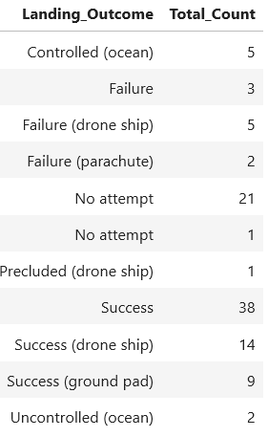
Total Number of Successful and Failure Mission Outcomes
%sql SELECT "Landing_Outcome", COUNT(*) AS Total_Count FROM SPACEXTBL GROUP BY "Landing_Outcome";
The COUNT(*) function counts the number of records for each unique Landing_Outcome.The GROUP BY "Landing_Outcome" clause groups the records by the Landing_Outcome field, so the query returns the total number of occurrences for each type of landing outcome (e.g., success, failure).

Slide 31
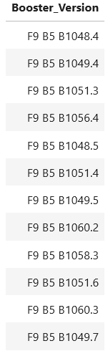
Boosters Carried Maximum Payload
%sql SELECT "Booster_Version" FROM SPACEXTBL WHERE "PAYLOAD_MASS__KG_" = (SELECT MAX("PAYLOAD_MASS__KG_") FROM SPACEXTBL);
The inner query (SELECT MAX("PAYLOAD_MASS__KG_") FROM SPACEXTBL) calculates the maximum payload mass in the entire dataset.The outer query then selects the Booster_Version names where the PAYLOAD_MASS__KG_ equals this maximum value.

Slide 32
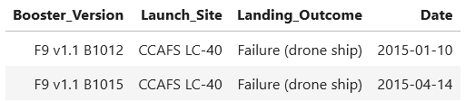
2015 Launch Records
%sql SELECT "Booster_Version", "Launch_Site", "Landing_Outcome", "Date" FROM SPACEXTBL WHERE "Landing_Outcome" = 'Failure (drone ship)' AND strftime('%Y', "Date") = '2015’;
The WHERE clause filters the records to include only those where:"Landing_Outcome" is 'Failure (drone ship)', meaning the landing attempt on the drone ship failed.strftime('%Y', "Date") = '2015' filters the records to only include those from the year 2015. The strftime function extracts the year from the Date column.The query selects the Booster_Version, Launch_Site, Landing_Outcome, and Date columns for the relevant records.

Slide 33
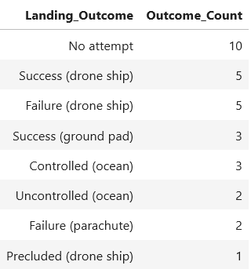
Rank Landing Outcomes Between 2010-06-04 and 2017-03-20
%sql SELECT "Landing_Outcome", COUNT(*) AS Outcome_Count FROM SPACEXTBL WHERE "Date" BETWEEN '2010-06-04' AND '2017-03-20' GROUP BY "Landing_Outcome" ORDER BY Outcome_Count DESC;
The WHERE clause filters the records to include only those where the Date falls between 2010-06-04 and 2017-03-20.The GROUP BY "Landing_Outcome" groups the records by the Landing_Outcome field, so that each unique outcome is counted. The COUNT(*) function counts the number of occurrences for each landing outcome. The ORDER BY Outcome_Count DESC sorts the results in descending order based on the count, ranking the most frequent outcomes at the top.

Slide 34

Section 3

Slide 35
<Folium Map Screenshot 1>
Replace <Folium map screenshot 1> title with an appropriate title
Explore the generated folium map and make a proper screenshot to include all launch sites’ location markers on a global map
Explain the important elements and findings on the screenshot

Slide 36
<Folium Map Screenshot 2>
Replace <Folium map screenshot 2> title with an appropriate title
Explore the folium map and make a proper screenshot to show the color-labeled launch outcomes on the map
Explain the important elements and findings on the screenshot

Slide 37
<Folium Map Screenshot 3>
Replace <Folium map screenshot 3> title with an appropriate title
Explore the generated folium map and show the screenshot of a selected launch site to its proximities such as railway, highway, coastline, with distance calculated and displayed
Explain the important elements and findings on the screenshot

Slide 38

Section 4

Slide 39
<Dashboard Screenshot 1>
Replace <Dashboard screenshot 1> title with an appropriate title
Show the screenshot of launch success count for all sites, in a piechart
Explain the important elements and findings on the screenshot

Slide 40
<Dashboard Screenshot 2>
Replace <Dashboard screenshot 2> title with an appropriate title
Show the screenshot of the piechart for the launch site with highest launch success ratio
Explain the important elements and findings on the screenshot

Slide 41
<Dashboard Screenshot 3>
Replace <Dashboard screenshot 3> title with an appropriate title
Show screenshots of Payload vs. Launch Outcome scatter plot for all sites, with different payload selected in the range slider
Explain the important elements and findings on the screenshot, such as which payload range or booster version have the largest success rate, etc.

Slide 42

Section 5

Slide 43
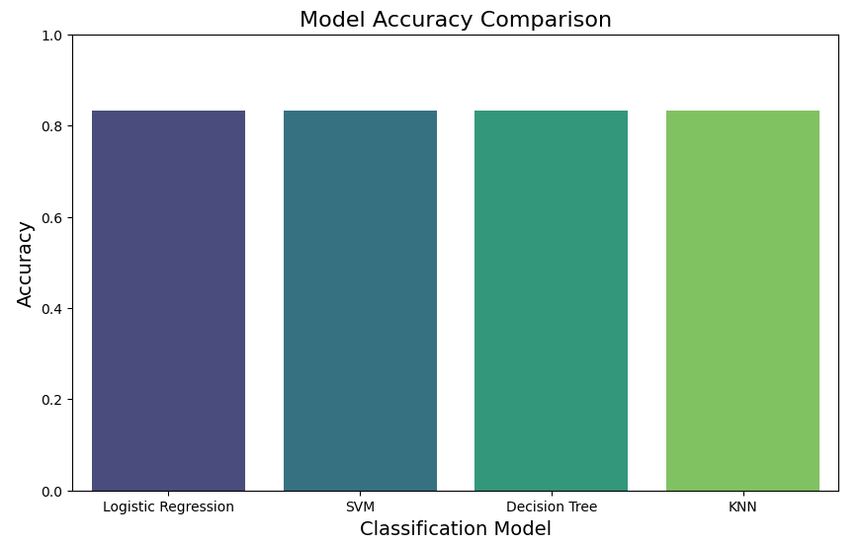
Classification Accuracy
Logistic Regression Test Accuracy: 0.8333
SVM Test Accuracy: 0.8333
Decision Tree Test Accuracy: 0.8333
KNN Test Accuracy: 0.8333
The best performing model is: Logistic Regression with an accuracy of 0.8333

Slide 44
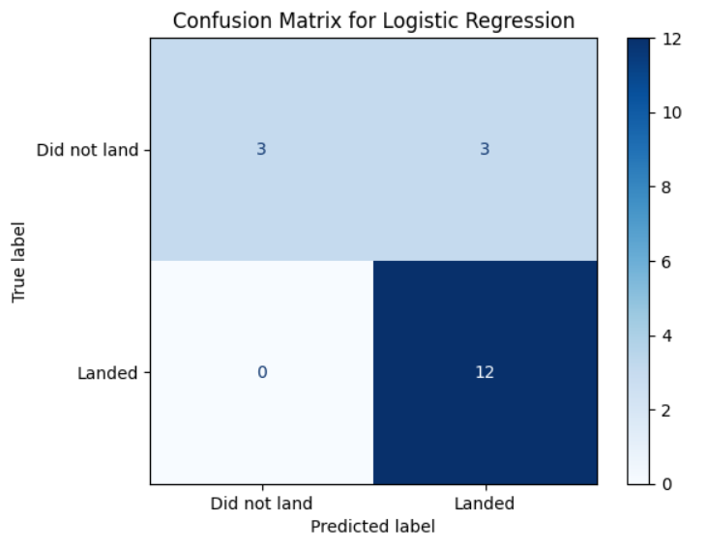
Confusion Matrix
True Positives (Bottom-Right, 12): The model correctly predicted that 12 rockets would successfully land. These are the cases where the model's prediction matched the actual outcome, indicating a successful prediction of a landing.
True Negatives (Top-Left, 3): The model correctly predicted that 3 rockets would not land. These are the cases where the model's prediction accurately reflected that the rocket would fail to land.
False Positives (Top-Right, 3): The model incorrectly predicted that 3 rockets would land when they actually did not. These are instances where the model was overly optimistic about a landing that did not occur.
False Negatives (Bottom-Left, 0): There were no instances where the model incorrectly predicted that a rocket would not land when it actually did. This indicates that the model was conservative in its predictions, not missing any successful landings.

Slide 45
Conclusions
Effective Data Collection and Processing:
Successfully gathered and processed SpaceX data using API calls and web scraping.
Data wrangling ensured the dataset was clean and ready for analysis.
Insightful Exploratory Data Analysis:
EDA revealed key patterns in launch sites, payloads, and landing outcomes.
Visualizations highlighted relationships between flight numbers, payload mass, and landing success.
Modeling Success:
Logistic Regression emerged as the best model for predicting landing outcomes.
The confusion matrix showed strong model performance, with accurate predictions of landing success.
Key Findings:
The analysis provided insights into SpaceX’s progress in landing technology.The study’s results can guide improvements in future SpaceX missions.

Slide 46
Appendix
Include any relevant assets like Python code snippets, SQL queries, charts, Notebook outputs, or data sets that you may have created during this project

Slide 47


